Slide 1
Retail Shop Billing System Java Mini Project Group 62

Slide 2
Requirement Gathering System Design and Documentation

Slide 4
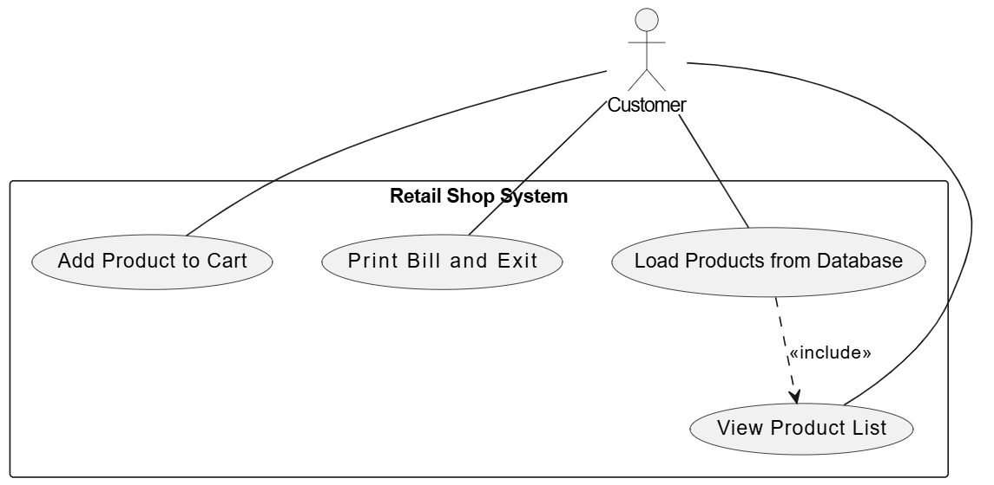
Use CASE DIAGRAM for Retail billing system

Slide 5
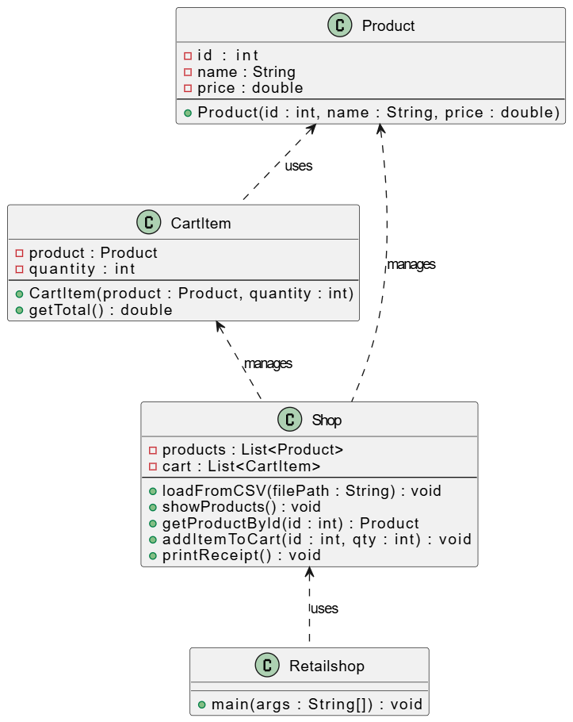
Class diagram for Retail billing system

Slide 6
Explain the benefits of our system
User Friendly : User Friendly Interface
Access Control: Our system is Protected by Password Authentication
Etc.

Slide 7

Classes and Functions Development

Slide 8
Explain the Functions

Slide 9

Quality Assurance
Beautifully Designed Retail Shop System with zero bugs

Slide 10
Exception Handling and Testing
These are the run time exceptions while impletation

Slide 11
Division of Workload

Slide 12

Thank you
Note:
Convert the final PowerPoint into PDF file

